Slide 1

Florida Electric Vehicles (EV)
Presented by
Sam Azhari
Christina Gangi
Joseph Williams
Altricia Latimer

Slide 2
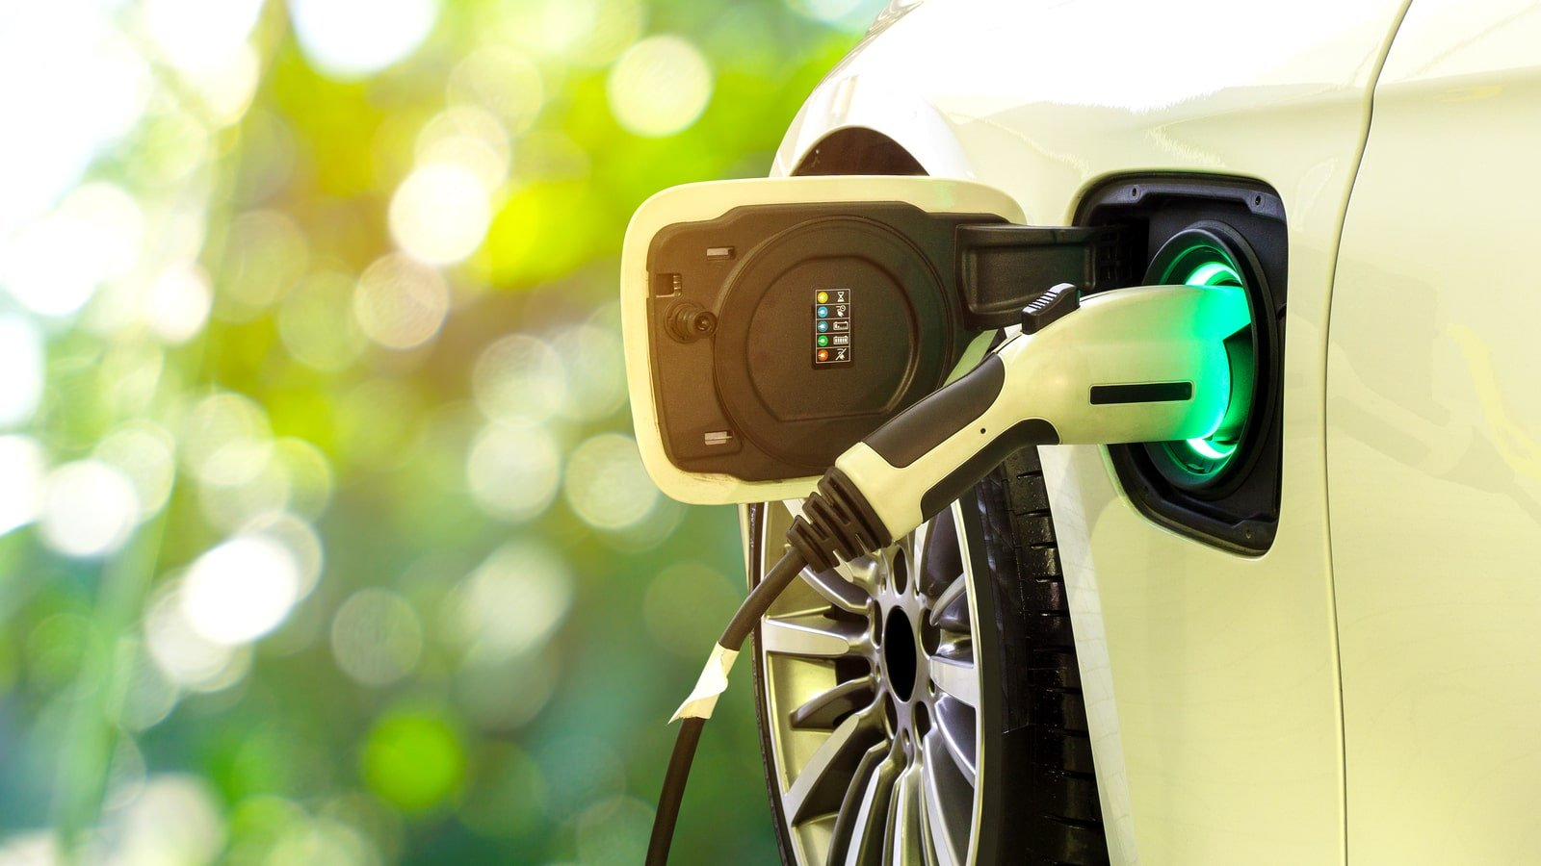
EV Cars Florida Story

Slide 3

EV Cars Environmental Impact

Slide 4
EV Cars Environmental Impact
Are Electric Cars Really Greener?
Are Electric Cars Really Better for the Environment?
Electrical Vehicles and EV Infrastructure
Transportation Electrification in Florida
Drive Electric Florida
Electric Cars vs. Gas Cars: Everything You Need to Know

Slide 5
Environmental Impact Driving Factors for EV Car Purchase
Environmental and sustainability objectives drive electric vehicle policy support at all governance levels
Policies are being tailored to support market transition
Electric car sales drive cost reductions in batteries, which boosts deployment across all road vehicle categories
Electric vehicles increase electricity demand but reduce oil demand and well-to-wheel greenhouse gas emissions
Battery technologies improve and costs drop
Battery manufacturing

Slide 6
EV Environmental Impact

Slide 7
Project Overview
Goal
Find Data
Clean Data
Store Data
Access Data
Filter Data
Chart Data

Slide 8
Project Overview
Goal
Find Data
Clean Data
Store Data
Access Data
Filter Data
Chart Data

Slide 9
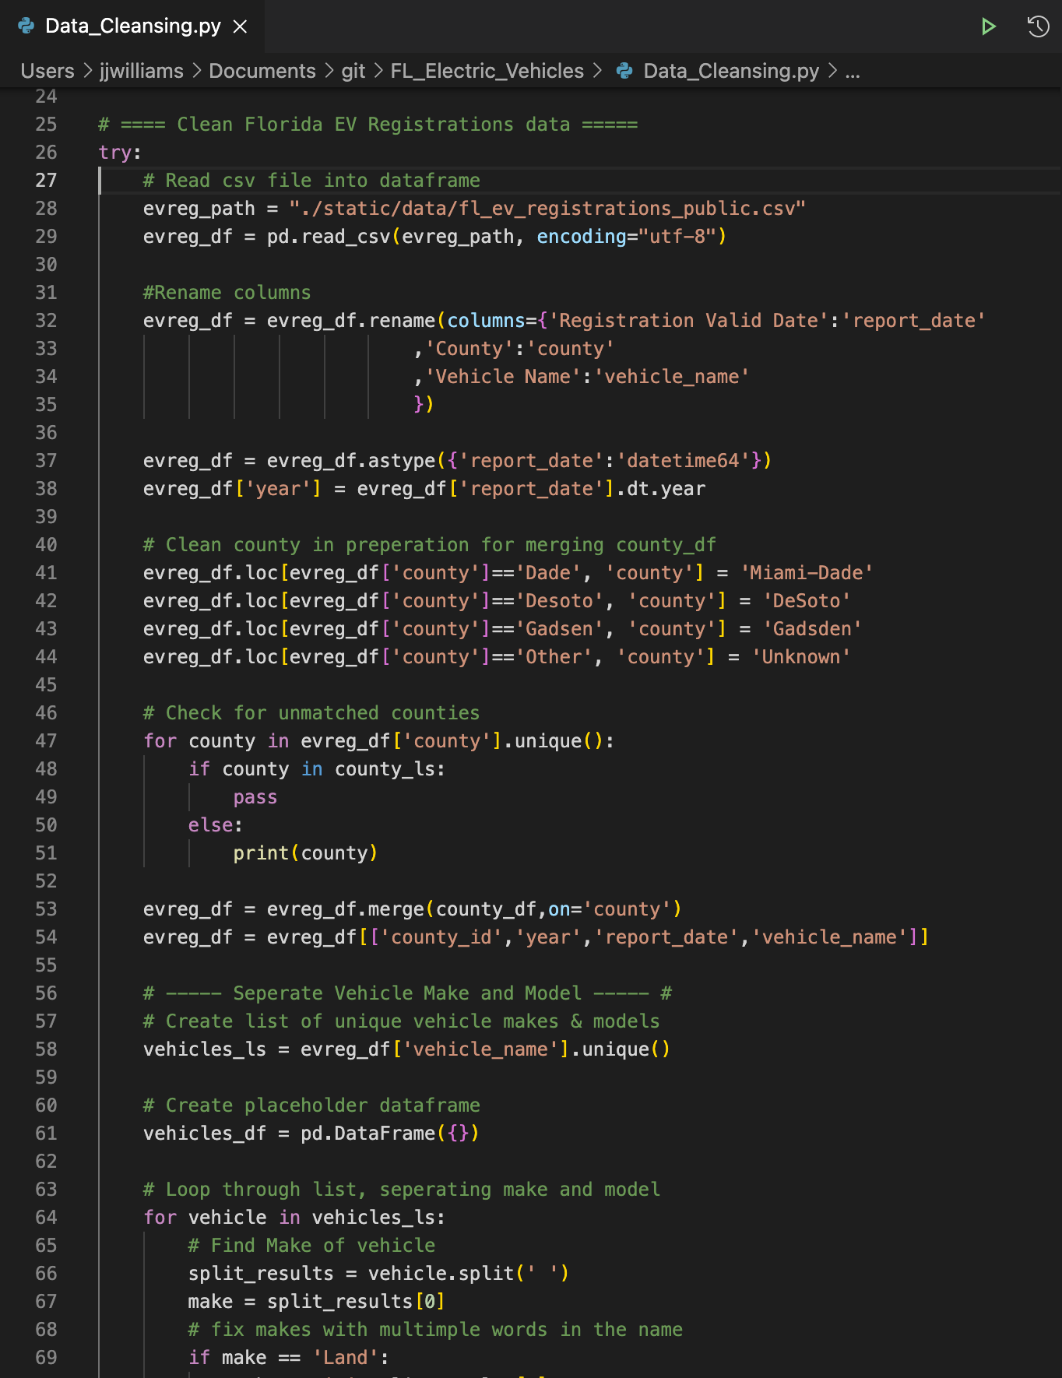



Find & Clean Data
Find Data
Clean Data
All data was for 2018,2019,2020
CSV of EV Registrations by county
CSV of EV Charging stations
API of Population & Income by county
Utilized Pandas and Python for most data cleaning

Slide 10
Project Overview
Goal
Find Data
Clean Data
Store Data
Access Data
Filter Data
Chart Data

Slide 11
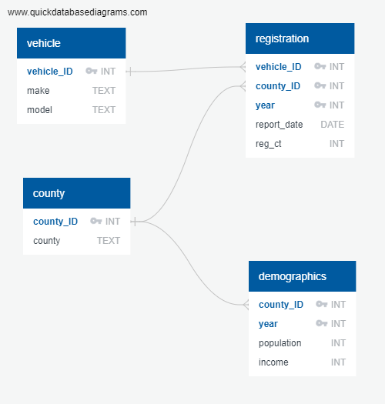
Store Data
SQLite Database
Vehicle table
County table
Registration table
Demographic table

Slide 12
Project Overview
Goal
Find Data
Clean Data
Store Data
Access Data
Filter Data
Chart Data

Slide 13
Access & Filter Data
Access Data
Filter Data
Setup a Flask app
Connect to SQLite DB
Setup 2 app routes
Home
Renders index.html template
Data
Runs SQL query to join tables
Returns query to json
Additional json files for map layers
Read json from data route with D3
Used .map and .filter to create unique variable with data needed for each specific visual
Passed that variable to build chart helper functions

Slide 14
Project Overview
Goal
Find Data
Clean Data
Store Data
Access Data
Filter Data
Chart Data

Slide 15
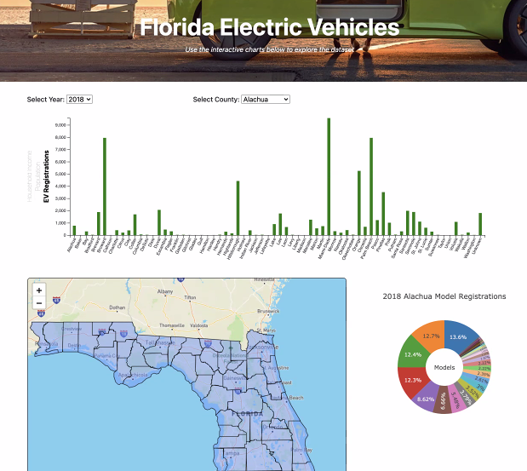
Dashboard app

Slide 16
Interactive Bar Chart comparing Household income, population & EV vehicle registration by counties

Slide 17
Interactive Map will include EV stations in each county

Slide 18
Static Pie Chart Will show EV Vehicles total models per County along with their market penetration Percentage

Slide 19

QUESTIONS?

